Slide 1

Sentiment Analysis
Twitter
Presented by Clivia Kong

Slide 2
BIO
Experiences & Skills
Financial Accountant with multiple commercial industry experiences
Financial Data analysis, budgeting and forecasting
Data Science and AI
Education
Master degree with Accounting and Commerce (MQ)
Bachelor degree of Financial Management (NJU)

Slide 3
01
Business & Data Overview
02
Exploratory Data Analysis
CONTENT
03
Data Pipeline and Features
04
Modelling and Evaluations

Slide 4
Business Context
Twitter is an open service that’s home to a world of diverse people, perspectives, ideas, and information. - Twitter
Every second, on average, around 6000 tweets are tweeted on Twitter!
Corresponding to over 350,000 tweets per Minute!
500 million tweets per day
200 billion tweets per year
Sentiment Analysis
NLP
How can we use machine to identify the sentiment of these vast volumes of tweets?

Slide 5
Business Context
Business Value
Sentiment Analysis
Organize massive amounts of tweets into information in real-time:
Be aware of negative reviews about an important product launch before it gets worse
Use positive comments to develop new products solve customers’pain points.
Understand the opinions of users about a variety of topics

Slide 6
Data Overview
3000 tweets sourcing from Kaggle open datasets
1500 Negative tweets, 1500 Positive tweets
Key features: Sentiment label, Tweet Content
Labels
Informal text
Sentiment | Tweet Content
Positive | Nice touch from www.wiggle.co.uk - complimentary bag of Haribo in my delivery of hiking clothes
Negative | Crazy wind today = no birding http://ff.im/1XTTi
Positive | @tracecyrus http://twitpic.com/7horz - This guitar is beautiful
Negative | Need a hug
Positive | and now go shopppppppping ROFL!!!!

Slide 7
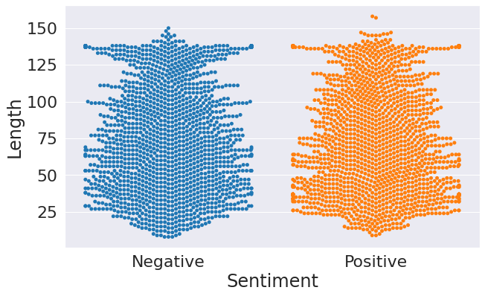
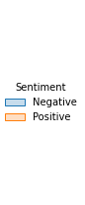
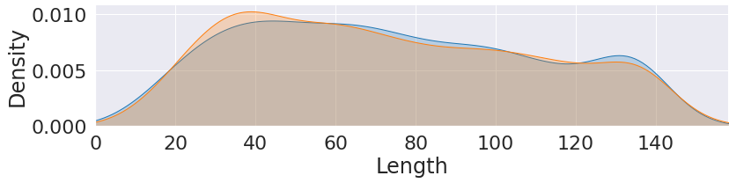
EDA
Length of positive tweets are similar with negative tweets
Positive tweets have more than 150 length text
Most of tweets’ length are in range from 20 to 140
People with positive emotions tends to post around 40 words text
People with negative emotions will text more words

Slide 8
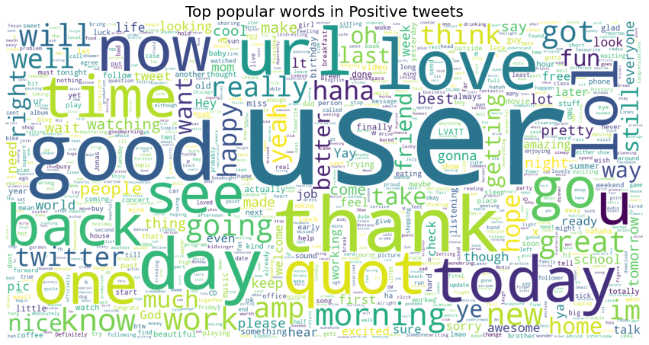
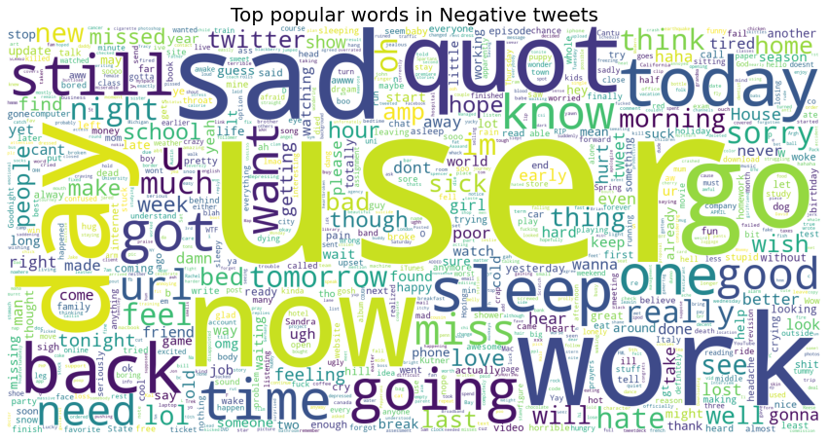
EDA
Positive Tweets
Like to @ friends or other users or share links to express positive emotions
Positive feelings: Thank, love, good
Negative Tweets
Like to @ more friends or users or rarely share links to express negative emotions
Negative feelings: Work, day, sad

Slide 9
Data Pipeline
Feature Engineering
Count Vector features
-Turn text to numbers
Tweets
Term frequency–inverse document frequency(TF-IDF)
- Add more weights on important words
13 features
EDA
Text- based features
Count characters
Count words
Word density = character count / word count
Punctuation count
Title word count
Uppercase word count
Models

Slide 10
Model Valuation
Classification Models Accuracy | Count Vectors | Word Level TF-IDF | N-Gram TF-IDF | CharLevel TF-IDF | Average Score
Logistic Regression | 0.711667 | 0.700000 | 0.645000 | 0.698333 | 0.685556
Naïve Bayes | 0.730000 | 0.715000 | 0.658333 | 0.721667 | 0.701111
Support Vector Machine | 0.690000 | 0.696667 | 0.645000 | 0.683333 | 0.677222
Random Forest | 0.700000 | 0.726667 | 0.616667 | 0.701667 | 0.677778
Gradient Boosting | 0.681667 | 0.690000 | 0.608333 | 0.688333 | 0.660000
Naïve Bayes has highest average score
Compare with ‘count vectors’ training set with ‘character level TF-IDF’ training set, I select TF-IDF because TF-IDF gives us a way to associate critical words with a number that represents who relevant this word is in whole sentence

Slide 11
Model Application
Naïve Bayes
I love data science
Positive
This event is not pleasant
Negative
No one likes rainy day
Negative
I'd really truly love going out in this weather!
Positive
Wish you all the best
Positive
May the Luck be with you
Positive

Slide 12
Conclusions and Next Steps
Conclusions
Model scores are similar in different models
Naïve Bayes have highest score
SVM doesn’t perform well
Next Steps
Training more data
More features can be fit into to seek potential improvements
Using emoji to boost sentiment analysis
Applying Bert Model to including connectivity between words

Slide 13
Questions?
Thanks for your watching!

Slide 14
References
https://primer.ai/business-solutions/what-is-nlp-and-why-do-you-need-it/
https://www.dsayce.com/social-media/tweets-day/#:~:text=Every%20second%2C%20on%20average%2C%20around%206%2C000%20tweets%20are%20tweeted%20on,200%20billion%20tweets%20per%20year.
https://blogs.sas.com/content/hiddeninsights/2018/07/16/role-emojis-sentiment-analysis/
https://www.researchgate.net/profile/Seyed-Ali-Bahrainian/publication/262211692_Sentiment_Analysis_and_Summarization_of_Twitter_Data/links/5f9a2c3f92851c14bcf082e0/Sentiment-Analysis-and-Summarization-of-Twitter-Data.pdf
https://www.analyticsvidhya.com/blog/2021/06/twitter-sentiment-analysis-a-nlp-use-case-for-beginners/
Data source: https://www.kaggle.com/datasets/kazanova/sentiment140/code?datasetId=2477&searchQuery=begin
GitHub: https://github.com/cliviaK/IOD/tree/main/Capstone-%20Twitter%20Sentiment%20Analysis_Clivia%20Kong
第一季度
28.7%

